Slide 1

Integrating Recommendation System to Creative Learning Web Framework
Group No. 1
Pratik Dhumal (19104031)
Kushal Todi (19104047)
Ruchita Raut (19104033)
Project Guide
Prof. Geetanjali Kalme

Slide 2
Contents
Abstract
Introduction
Objectives
Literature Survey
Problem Definition
Technological Stack
Proposed System Architecture/Prototype
Implementation

Slide 3
1. Abstract
The Internet has an enormous amount and variety of educational resources. As multidisciplinary educational interest grows, it is becoming increasingly important to support students’ course choices.
Our project recommends a collaborative filtering-based algorithm for the course recommender to aid students’ decision-making.
In this algorithm, the cosine similarity is used in accordance with the history of students’ course selection records, and better accuracy is obtained in the recommendation task, which satisfies user needs.
The system employs item-based and user-based collaborative filtering approaches from an algorithmic standpoint.

Slide 4
2. Introduction
Problem Identified :
    One of the problems faced is the scalability of algorithms having real-world datasets under the recommendation system, a huge changing data is generated by user-item interaction in the form of ratings and reviews and consequently, scalability is a big concern for these datasets.
    Due to insufficient course descriptions, the relative importance of certain courses may not be fully understood. When students want to take courses closely related to their specific career path, certain courses in that field may be more relevant than others that are not immediately apparent to the student, resulting in poor decisions once again.

Slide 5
2. Introduction
Solution Proposed :
    To solve the scalability problem we will be using cosine similarity which consumes less computing power for the huge datasets.
    We propose a hybrid recommendation system, i.e. a combination of collaborative and content based filtering methods, that suggests courses by finding students similar to the target students and then searching for a pattern in their understanding of the domains and courses that they took.

Slide 6
3. Objectives
To provide recommendations to the user based on the recorded information on the users’ preferences, such as his searches, course visits, etc.
To provide a collaborative-based recommendation after the user logs in to the portal, using Python.
To provide a content-based recommendation to the user based on his searches, preferences, and the courses he is enrolled in, using Python (ML) with similarity methods.
To classify the courses with specific keywords, learn what the customer likes, look up those terms in the database, and then recommend similar things with the help of a method i.e. cosine similarity.
To filter the courses based on ratings, courses enrolled by the user, paid as well as a free subscription.

Slide 7
4. Literature Survey
In the paper [1], Zheng Chen has proposed a recommendation algorithm based on collaborative filtering for the course recommender to help students’ decisions. In this algorithm, the improved cosine similarity is used, according to the history of students’ course selection records, and better accuracy is obtained in the recommendation task, which meets the needs of users
In the paper [2], Tessy Badriyah has proposed a recommendation system developed which is expected to be able to solve cold-start problem when there is no other relevant data to be recommended for the new added product and also the sparsity problem.
In the paper [3], Lianfen Zhao has carried out recommendation through data analysis, the implicit behavior data such as user login details, learning details and course selection details are mined, and the online course intelligent is combined with the collaborative filtering algorithm based on items.

Slide 8
5. Problem Definition
Integrating a recommendation system to a creative learning web framework using hybrid recommendation, i.e. using collaborative and content-based algorithms, for better user experience and solving the problem of scalability of the system.

Slide 9
6. Technology Stack
- Python (Version 3.10.0)
- React JS (Version 18.2.0)
- Flask (Version 2.2.2)
- Firebase (Version 11.0.1)
- MongoDB (Version 6.0)
- Collaborative & Content Based Filtering (Cosine Similarity)

Slide 10
7. Proposed System Architecture/Prototype
Existing research on collaborative filtering often uses methods such as fuzzy reasoning and genetic algorithms to solve the sparsity and cold start problems, while ignoring the fuzziness of users’ choices.
We propose a hybrid recommendation system, i.e. a combination of collaborative and content-based filtering methods, that suggests courses by finding students similar to the target students and then searching for a pattern in their understanding of the domains and courses that they took.
Finally, the system recommends courses whose association with the target student’s job profiles and preferences is high.

Slide 11
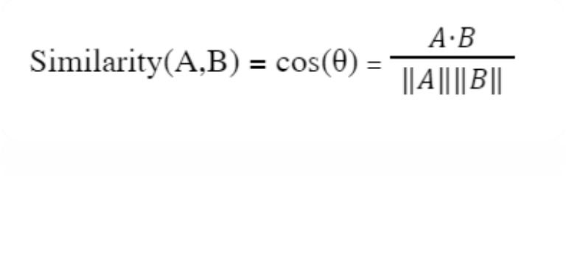
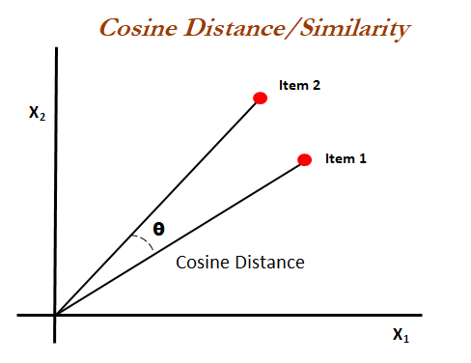
Formula for and concept for cosine similarity is :-
Fig. 7.1

Slide 12
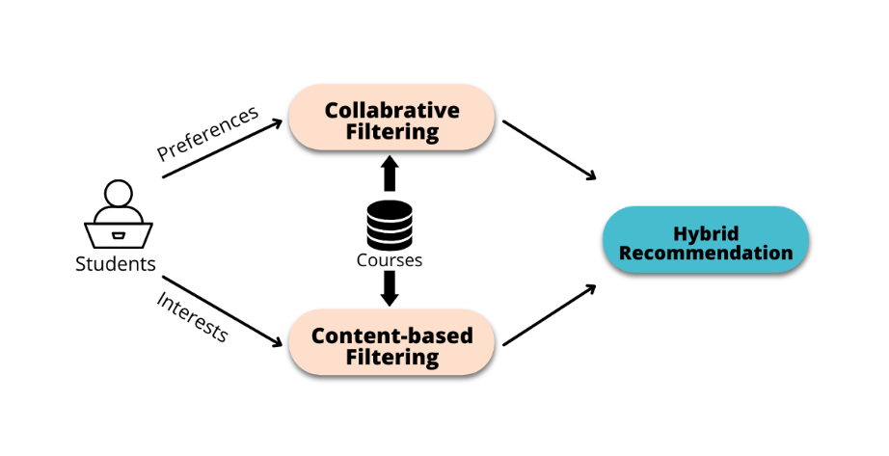
Fig. 7.2 - Architecture of the Hybrid Recommendation System

Slide 13

8. Implementation
Fig 8.1: Course Catalogue Page

Slide 14
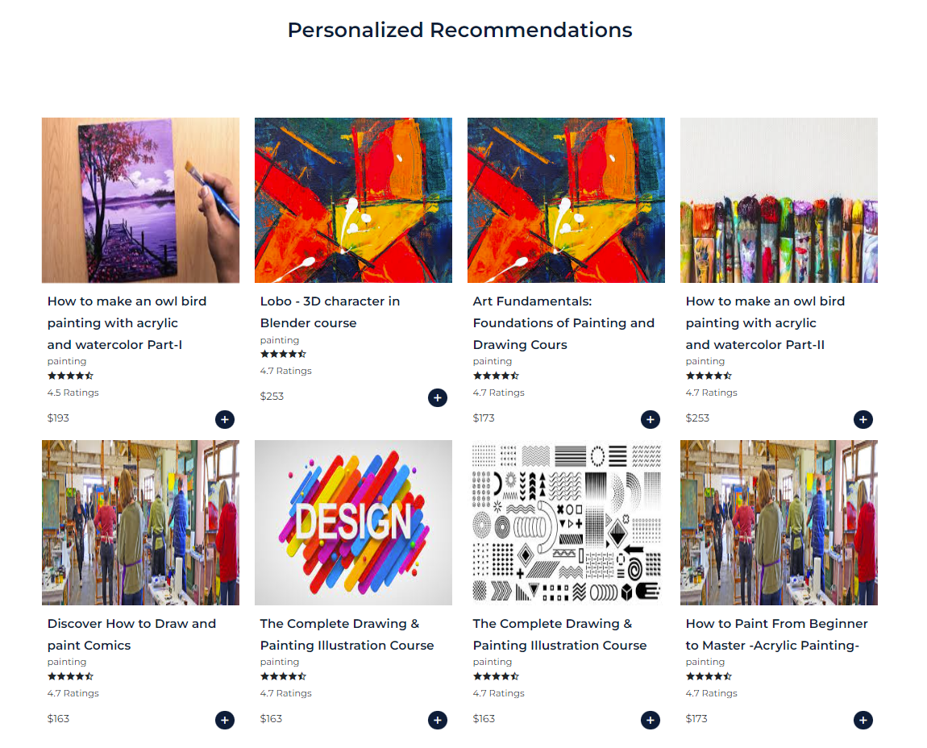
8. Implementation
Fig 8.2: Recommendation Page

Slide 15
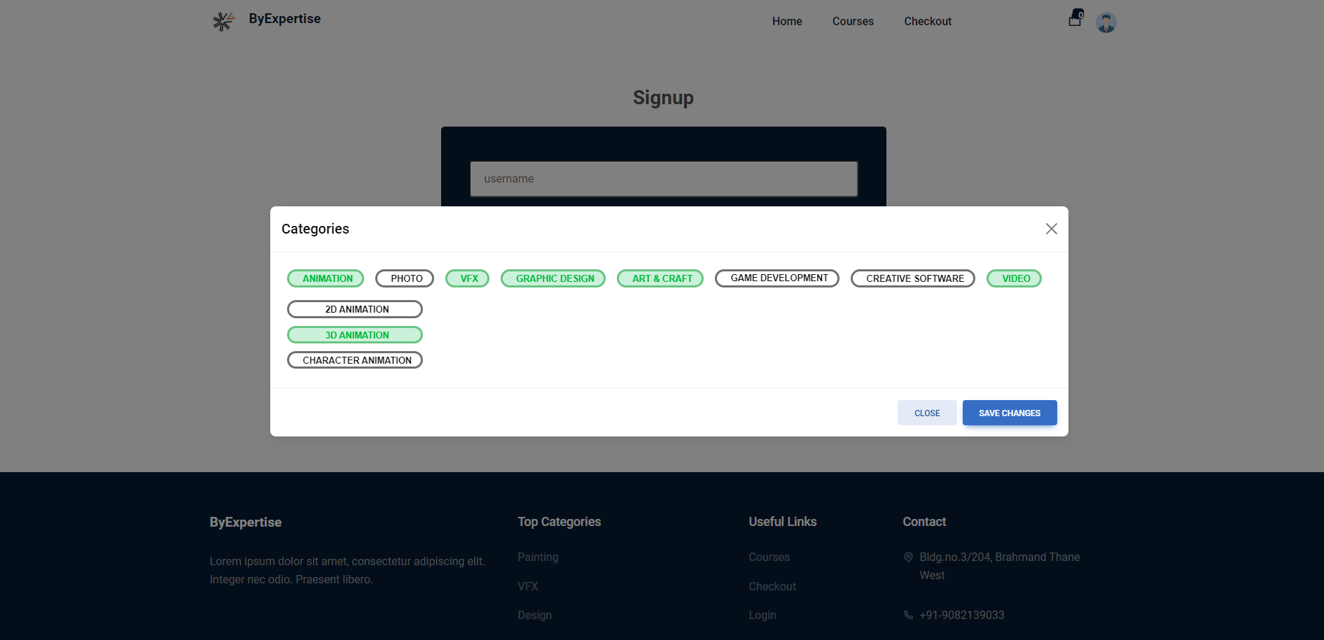
8. Implementation
Fig 8.3: User Interested Categories

Slide 16
8. References
[1] - Improved course recommendation algorithm based on collaborative filtering
[2] – Tessy Badriyah; Yunaz Gilang Ramadhan; Iwan Syarif, 2020 An Efficient Framework of Hybrid Recommendation System based on Multi Mode
[3] - L. Zhao and Z. Pan, "Research on Online Course Recommendation Model Based on Improved Collaborative Filtering Algorithm," 2021 IEEE 6th International Conference on Cloud Computing and Big Data Analytics (ICCCBDA), 2021, pp. 437-440, doi: 10.1109/ICCCBDA51879.2021.9442575.

Slide 17
Thank You...!!

